Slide 1


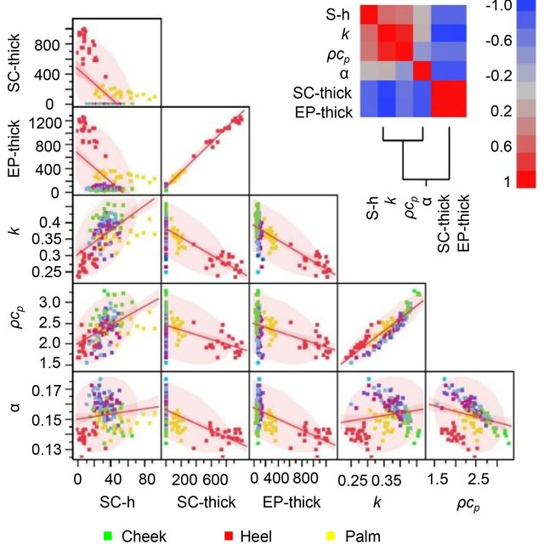
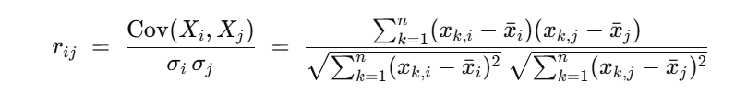
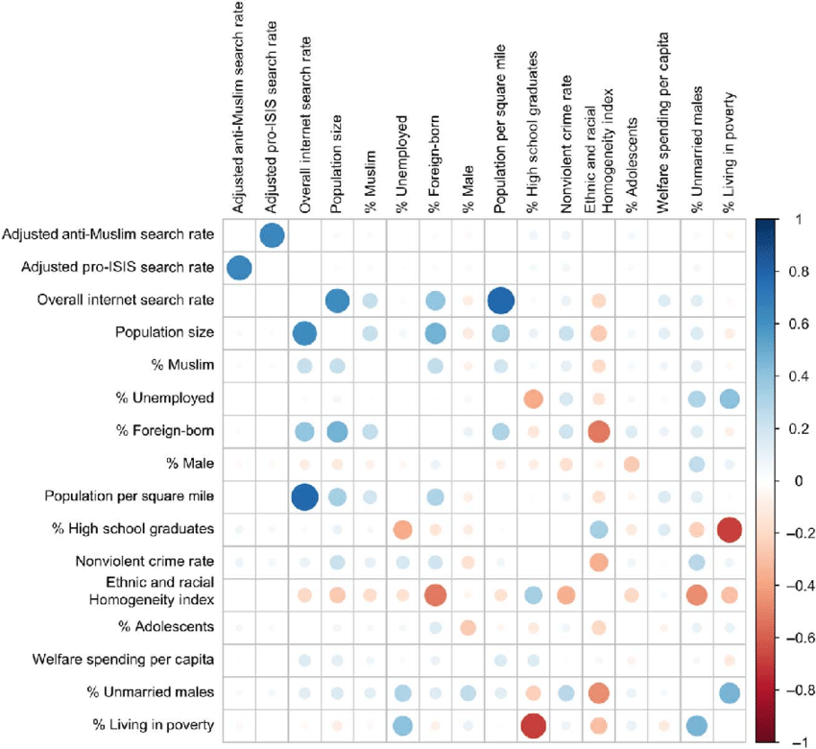

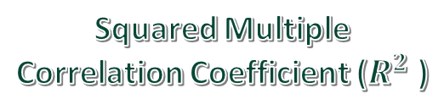
K. J. Somaiya School of Engineering, Mumbai – 400 077
(A Constituent College of Somaiya Vidyavihar University)
S.Y. B. Tech. Semester – I (2024-2025)
Probability Statistics Optimization Techniques (PSOT) IA-II
Application of Multivariate Correlation
Name : Shreyans Tatiya
Roll No : 16010123325
Div. : E2 Subject: PSOT IA2
Description
Multivariate correlation measures relationships between multiple variables, helping to identify patterns and dependencies in complex datasets. It's widely used in fields like economics, biology, and social sciences to assess how several factors influence outcomes. By quantifying associations, it aids in predictive modeling, feature selection, and data analysis, making it invaluable in decision-making processes.
Equations
Fourier Series Decomposition
Squared Multiple Correlation Coefficient ($R^{2}$ )

Slide 2

Application of Multivariate Correlation
Dynamics
Application of Multivariate Correlation
Limitations
Limitation | Description
Only Linear | Cannot detect non-linear relationships between variables.
No Causality | Correlation does not imply a cause-effect relationship.
Sensitive to Outliers | Extreme values can distort correlation values significantly.
Multicollinearity Risk | High inter-correlation can destabilize regression models..
Dimensionality Issues | Large variable sets can lead to complex, noisy matrices.
Data Quality Dependence | Requires clean, well-normalized data for accurate results.
Aspect | Description
Correlation Matrix | Captures pairwise correlations among all variables in a compact form.
Dimensional Analysis | Helps in identifying redundant or highly correlated variables.
Predictive Modeling | Improves model accuracy by selecting relevant correlated features.
Multicollinearity | Detects variables that might distort regression coefficients.
Vizualization | Heatmaps and PCA plots offer intuitive understanding of variable relationships.
Multivariate correlation helps uncover relationships among several variables simultaneously.
It supports better decision-making in data-rich domains like finance and healthcare.
Useful in identifying variable clusters and reducing model complexity.
Enhances feature selection and improves accuracy in machine learning models.
Aids in visualizing data structure through correlation matrices and PCA.
Enables detection of multicollinearity, strengthening model reliability.
Though limited to linear patterns, it's crucial in multivariate data exploration.
Conclusion
References
With the harmony of variables in motion, multivariate correlation unveils the intricate web of relationships, capturing the true rhythm of complex data dynamics.
https://www.sciencedirect.com/science/article/abs/pii/000326709187040E
https://www.sciencedirect.com/science/article/abs/pii/S0169743911000529
https://pmc.ncbi.nlm.nih.gov/articles/PMC3690333/

